Slide 1

Introduction of Neural Network for Deep Learning
Zendi Iklima ST SKom MSc

Slide 2
A brief history of NN
1943
1958
1965
1969
1975
1992
2009
Warren
McCulloch
&
Walter Pitts
Frank
Rosenblatt
Alexey
Ivankhnenko
&
Lapa
Marvin
Minsky
&
Seymour Papert
Paul Werbos
Max Pooling
Jurgen
Schmidhuber
Solved XOR problem using NN Back-Propagation
Created the first mathematical model and algorithms of NN
Created the first pattern recognition (the Perceptron)
NN Feasibility of Machine Learning
3D Object Recognition (with least shift invariance and tolerance of deformation)
Pattern Recognition and Machine Learning
Created the first MLP
Notes:
http://neuralnetworksanddeeplearning.com/
https://medium.com/fintechexplained/neural-networks-activation-function-to-back-propagation-understanding-neural-networks-bdd036c3f29f
https://medium.com/explore-artificial-intelligence/build-your-own-neural-network-2-our-first-neural-network-architecture-7e80c081d264
https://medium.com/stupid-simple-ai-series/the-truth-about-neural-networks-70ec055d1e9b
https://towardsdatascience.com/building-your-first-neural-network-using-keras-29ad67075191

Slide 3
What is Neural Network
A good way to think of an NN is as a composite function. You give it some input and it gives you some output.
In an artificial intelligence neural network, multiple algorithms work together to perform calculations on input data to compute an output. These outputs can also help neural network to learn and improve their accuracy.

Slide 4
Main Components: Neuron
Neurons (Set of functions)
A number of neurons are grouped into layers.
All neurons within the same group perform similar type of function.
To explain, input neurons receive inputs, process it and pass it to the neurons in next successive layer. Hidden neurons take outputs from input neurons, compute new outputs and pass them to successive layers

Slide 5
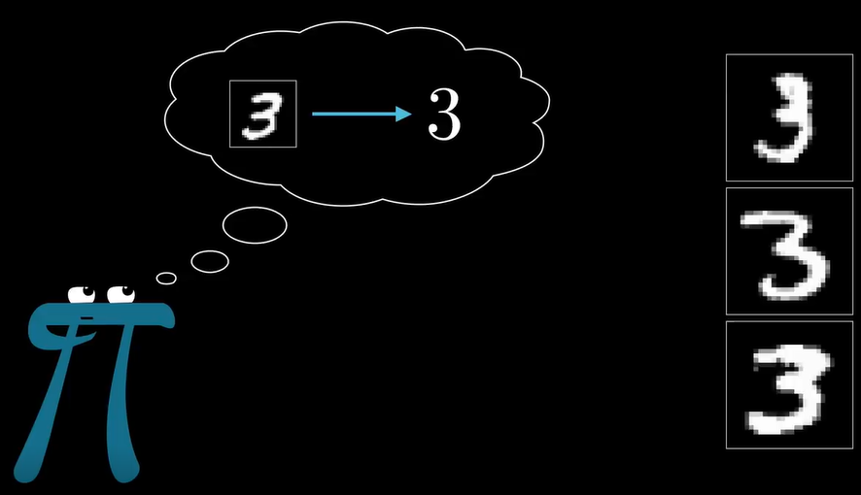

Slide 6
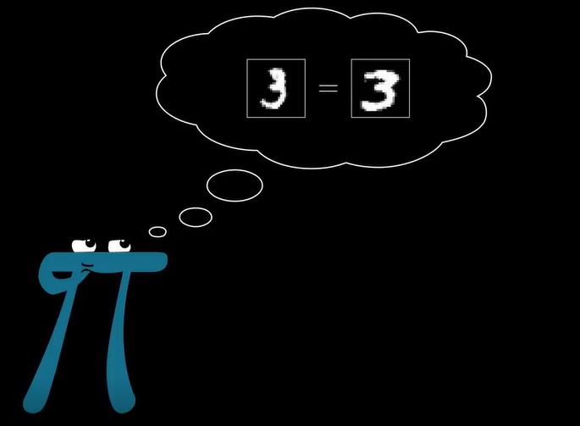
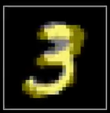
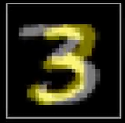

Slide 7
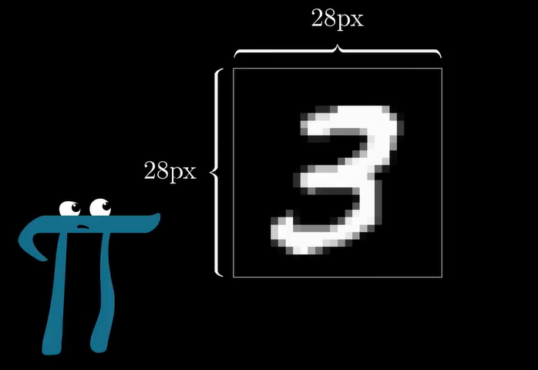

28 pixels
28 pixels

Slide 8
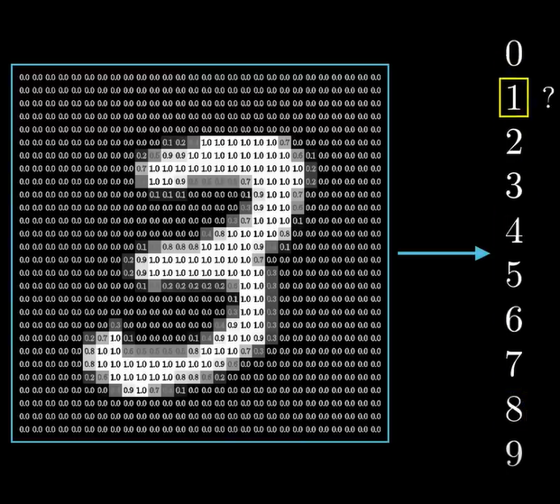

Slide 9
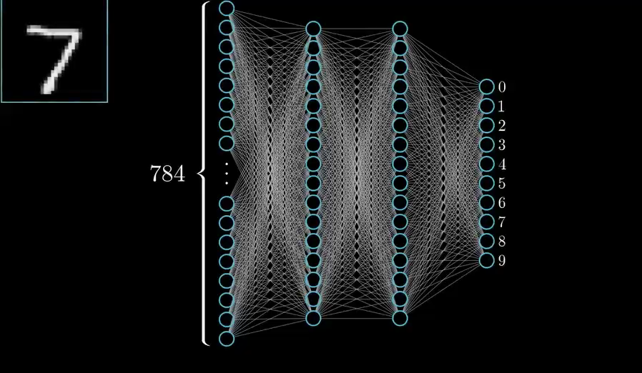

Slide 10
Main Components: Layers
Layers (Grouping of neurons)
Contain neurons and help pass information around. There are at minimum two layers in a neural network: Input and Output layer.
We can have a large number of layers in a complex neural network.
The layers, other than the input and output layers, are known as hidden layers.

Slide 11
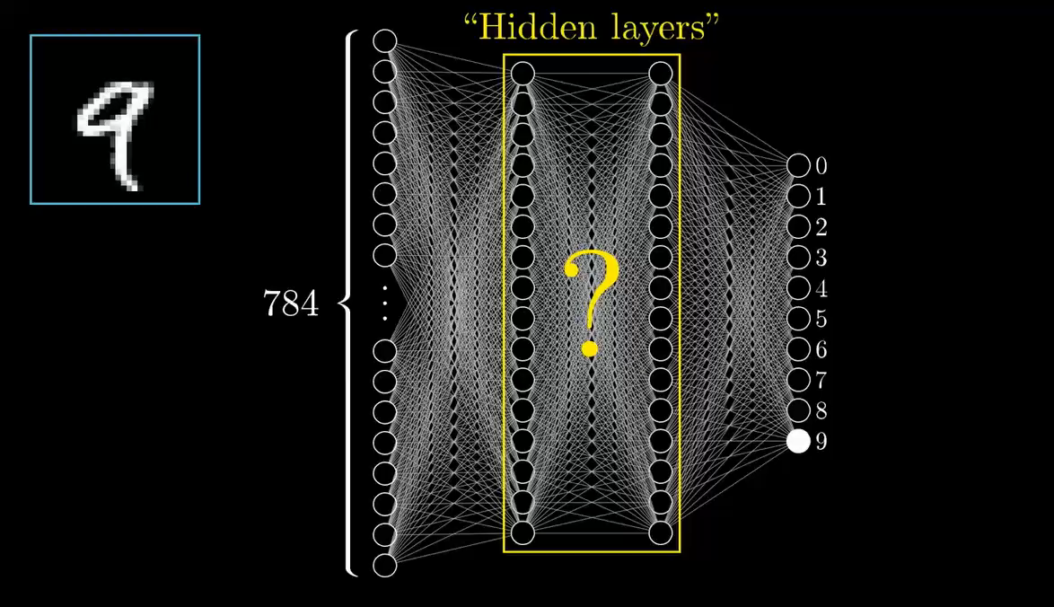

Slide 12
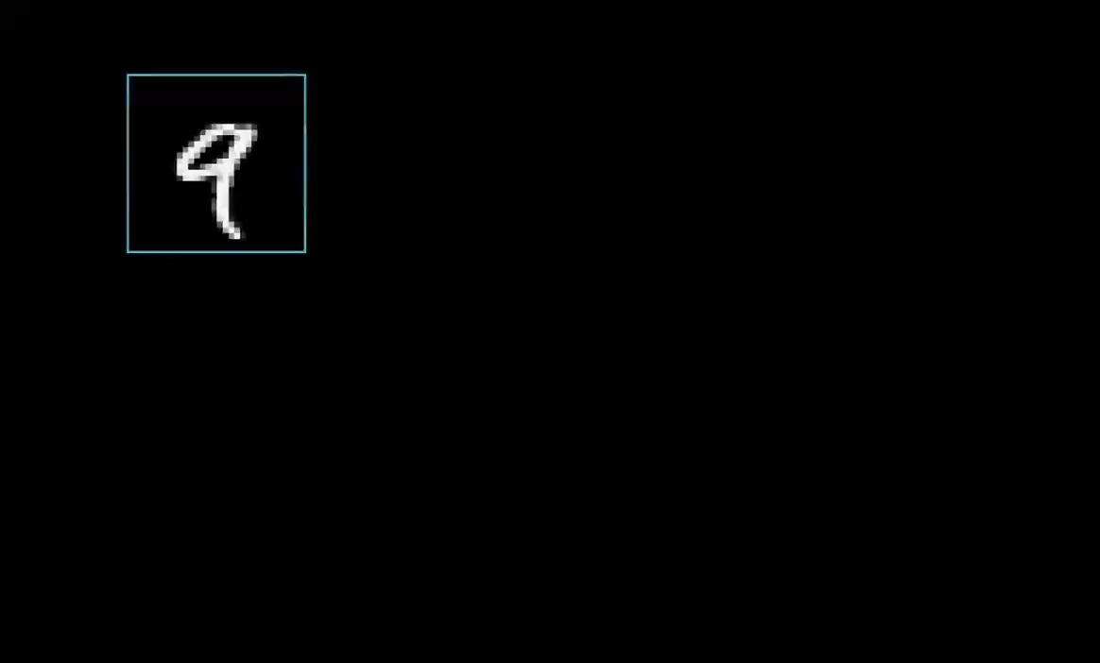

Slide 13
Main Components: Activations
Activation Function: Mathematical algorithms applied to outputs
Essentially activation functions smooth or normalize the output before it is passed on to the next or previous neurons in the chain.
These functions help neural networks learn and improve themselves.
Neural Networks Is A Machine Learning Concept Modeled On Biological Brain

Slide 14
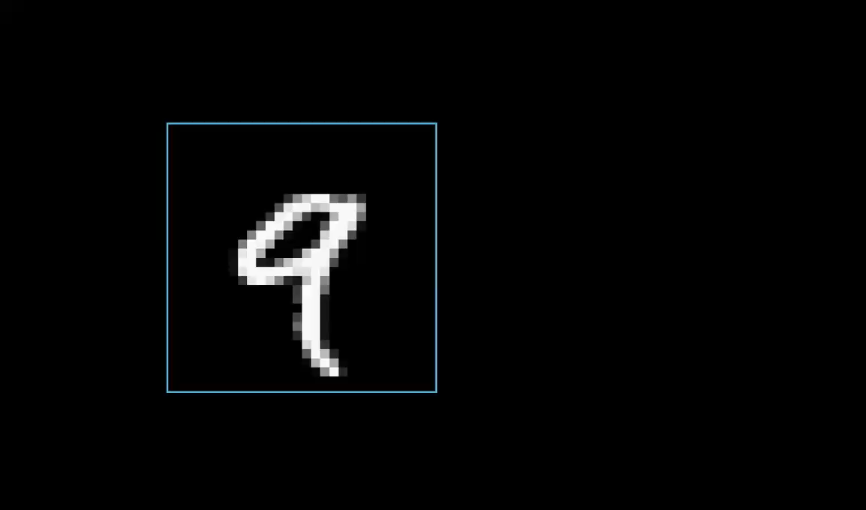

Slide 15
Main Components: Weights & Biases
Weights & Biases: Numerical Values
These are essentially variables in the model that are updated to improve network’s accuracy. A weight is applied to input of each of the neuron to compute an output.
Neural networks update these weights on continuous basis. Hence there is a feedback loop implemented in most neural networks.
Think of weight as input importance of a neuron.
Biases are also numerical values which are added once weights are applied to inputs. Hence weights and biases make neural networks self-learning algorithms.

Slide 16
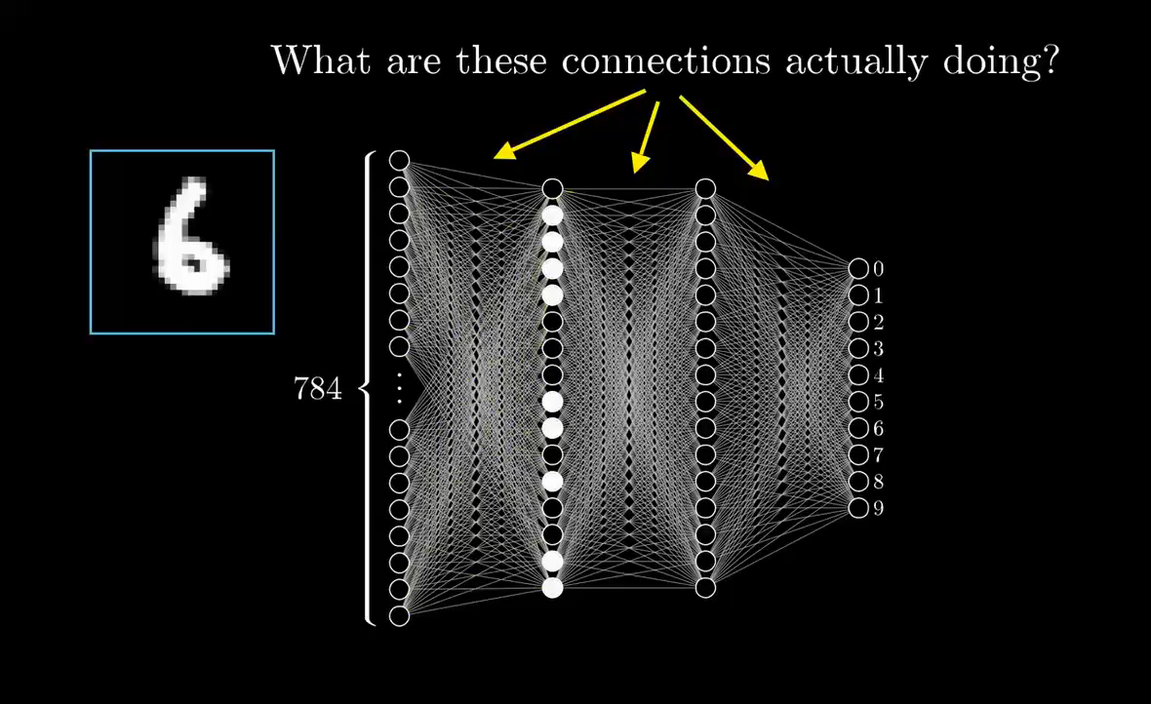

Slide 17
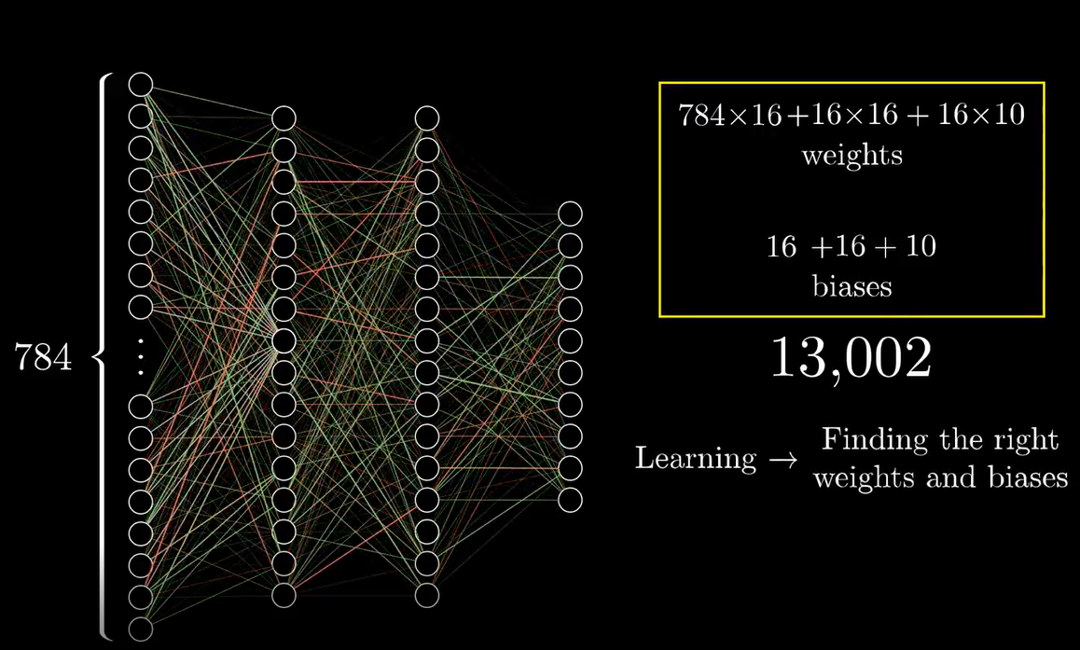

Slide 18
Main Components: Activations
Activation Function: Mathematical algorithms applied to outputs
Essentially activation functions smooth or normalize the output before it is passed on to the next or previous neurons in the chain.
These functions help neural networks learn and improve themselves.
Neural Networks Is A Machine Learning Concept Modeled On Biological Brain

Slide 19
Main Components: Activations
As the name implies, activation function is a mathematical formula (algorithm) that is activated under certain circumstances.
When neurons compute weighted sum of inputs, they are passed to the activation function which checks if the computed value is above the required threshold.
If the computed value is above the required threshold then the activation function is activated and an output is computed.
If we plot non-linear outputs that the activation functions produce, we will get a curvature. The slope of the curve is used to compute the gradient. Gradient helps us in understanding rate of change and relationships of variables.

Slide 21
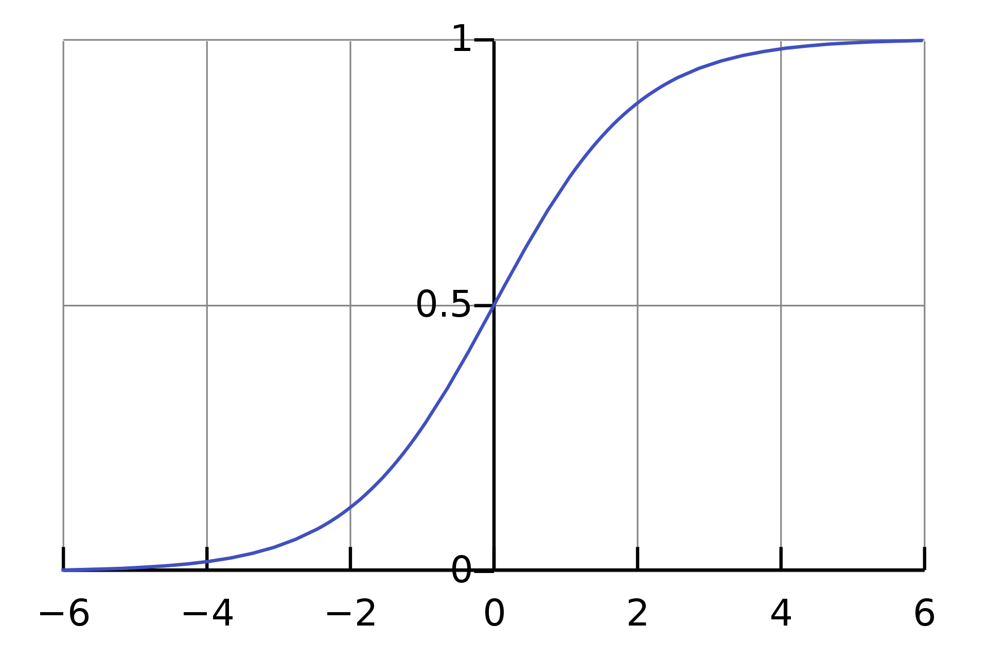
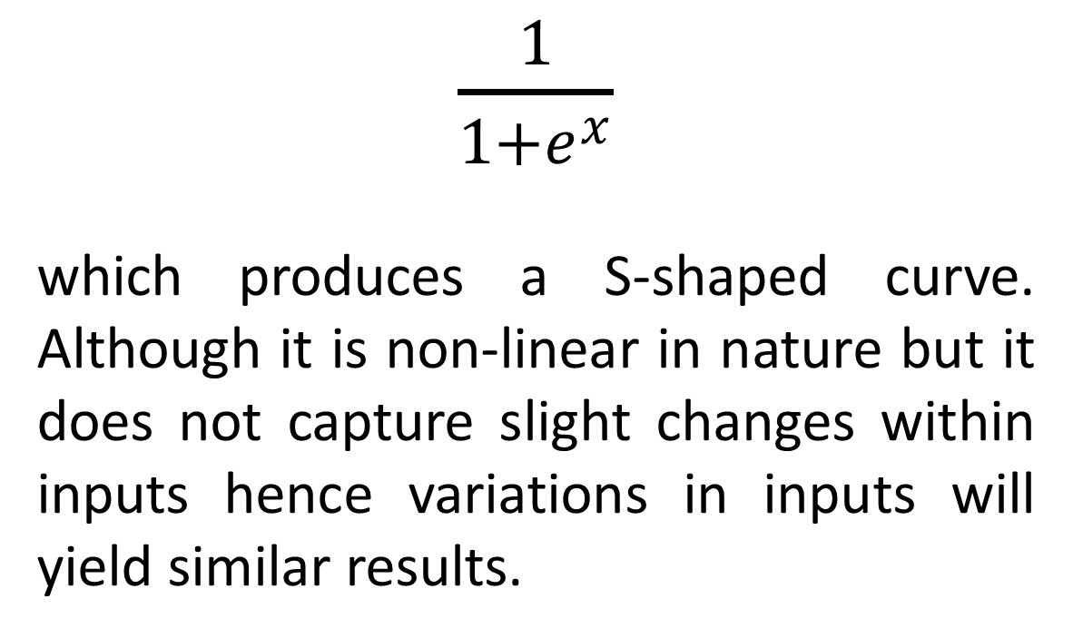
Type of Activation Functions
Sigmoid
$\frac{1}{1+e^{x}}$
which produces a S-shaped curve. Although it is non-linear in nature but it does not capture slight changes within inputs hence variations in inputs will yield similar results.

Slide 22
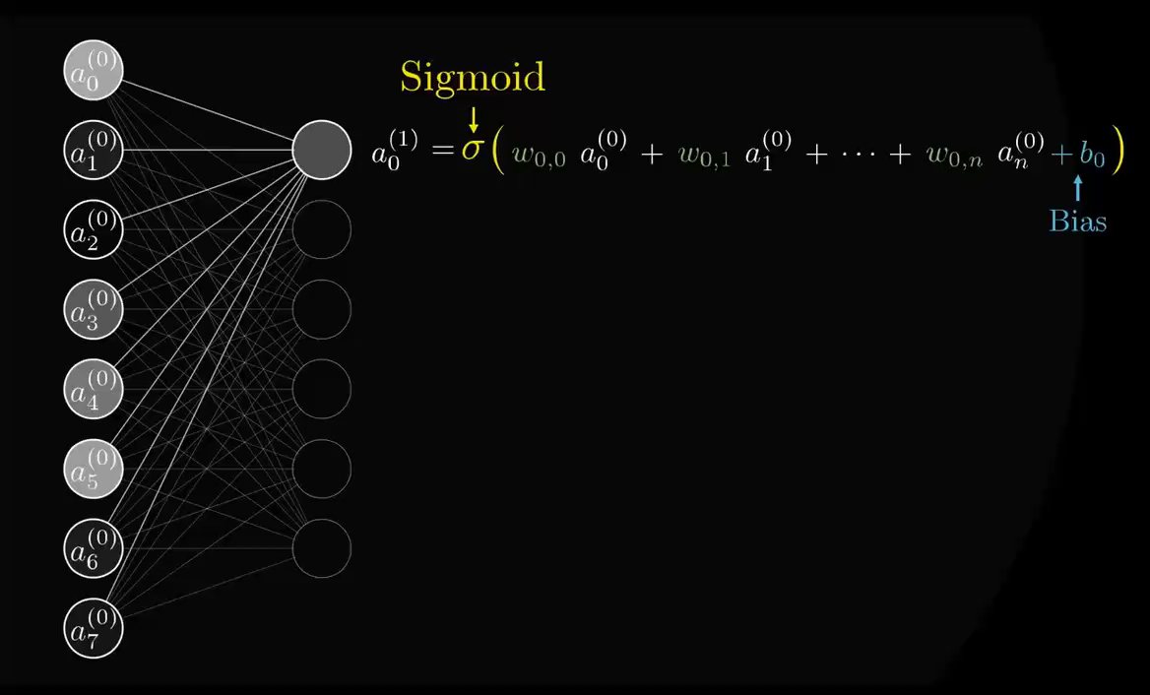

Slide 23
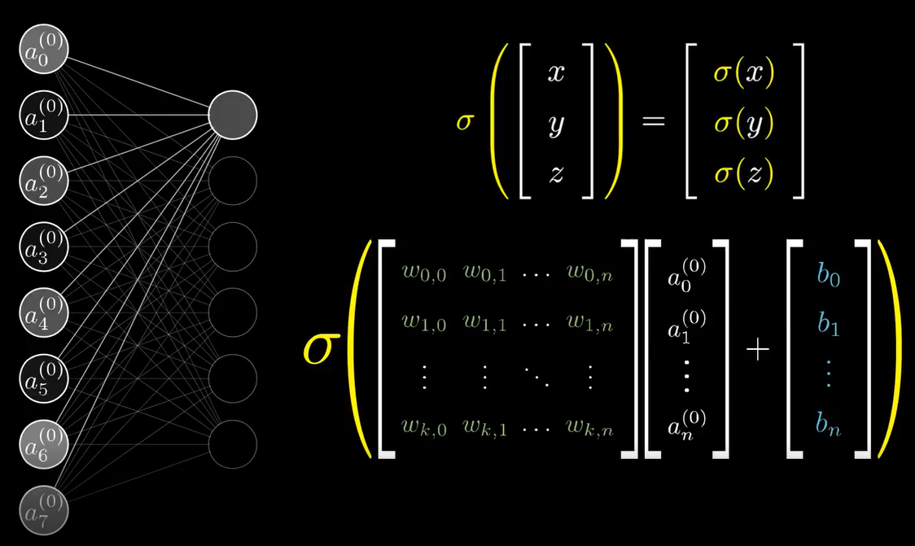
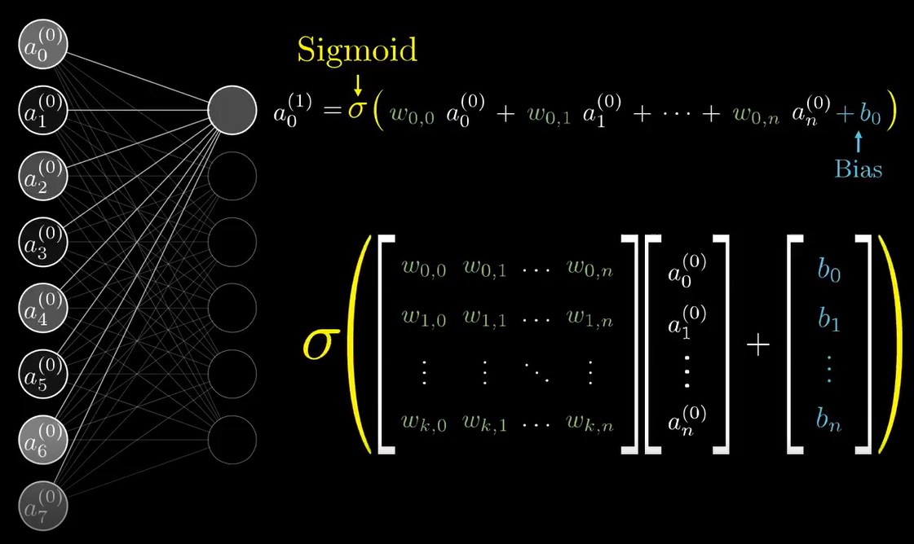
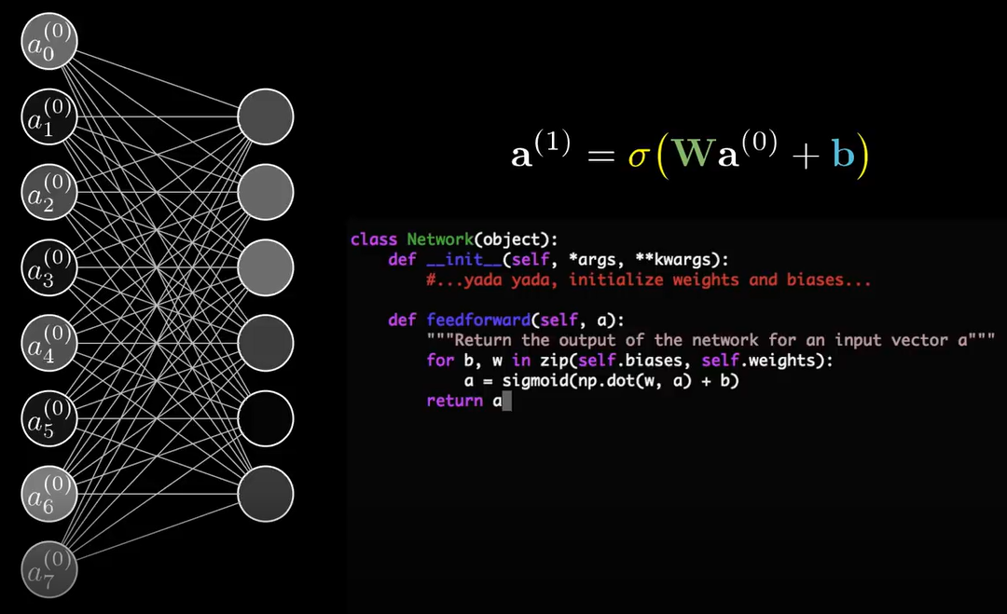
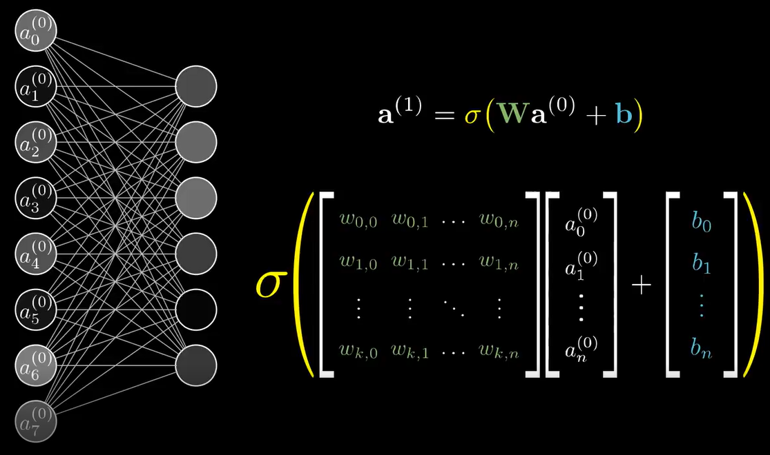

Slide 24
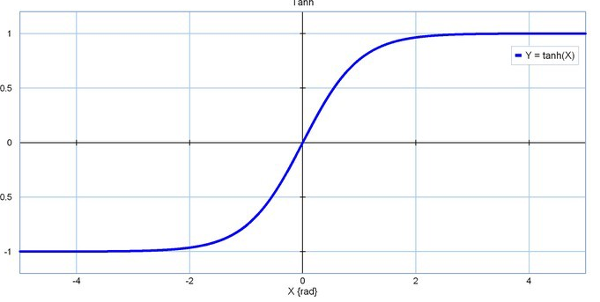
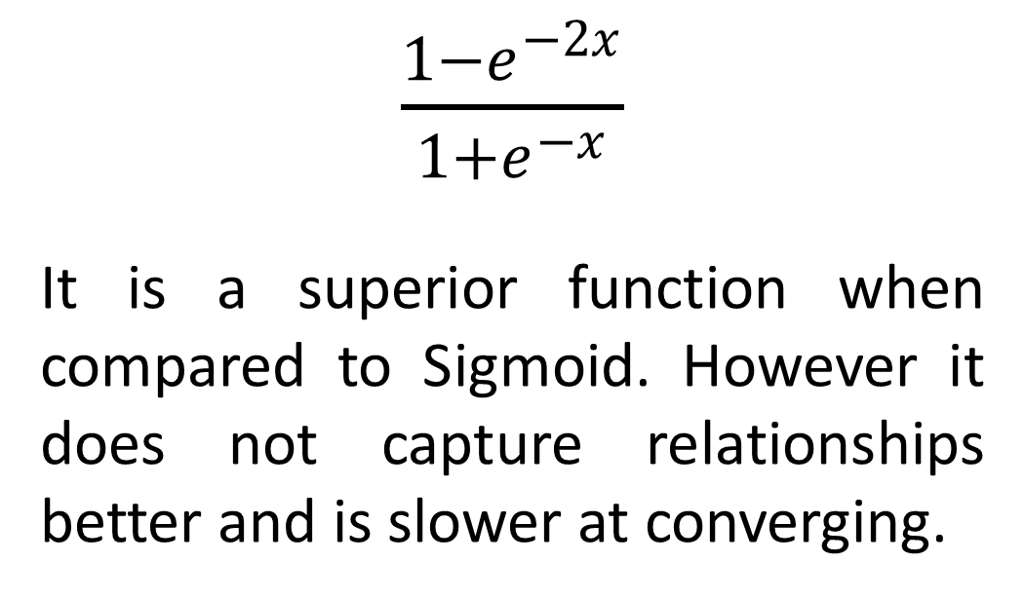
Type of Activation Functions
Hyperbolic Tangent Functions (Tanh)
$\frac{1−e^{−2x}}{1+e^{−x}}$
It is a superior function when compared to Sigmoid. However it does not capture relationships better and is slower at converging.

Slide 25
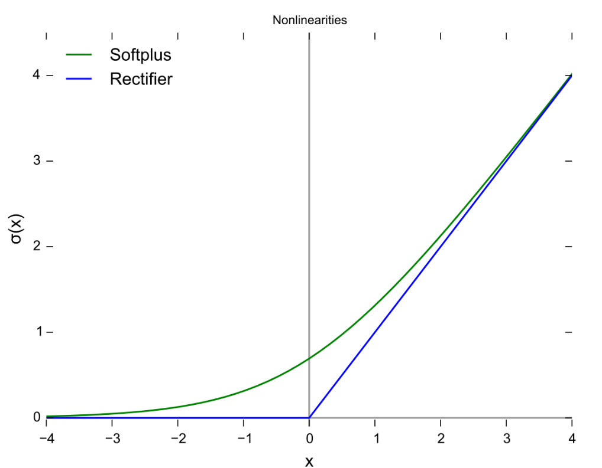
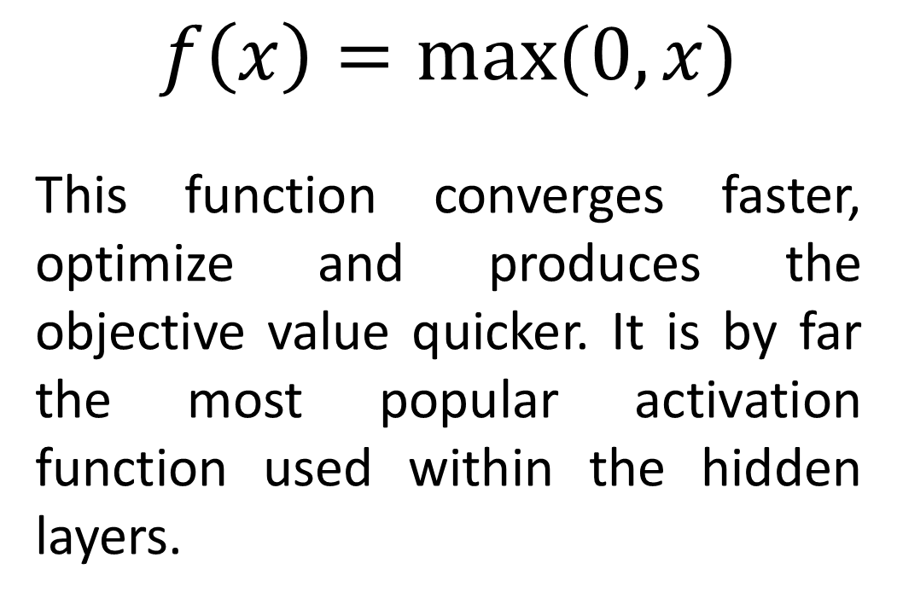
Type of Activation Functions
Rectified Linear Units (ReLu)
$$f\left(x\right)=max⁡(0, x)$$
This function converges faster, optimize and produces the objective value quicker. It is by far the most popular activation function used within the hidden layers.

Slide 26
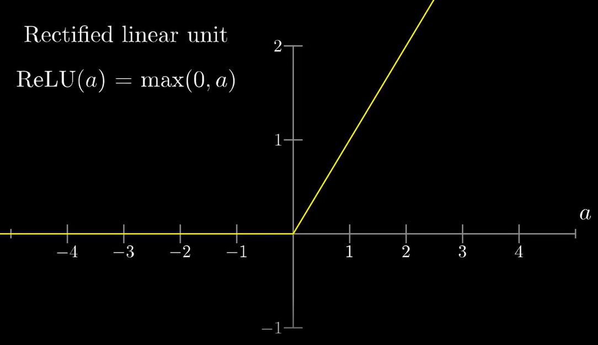
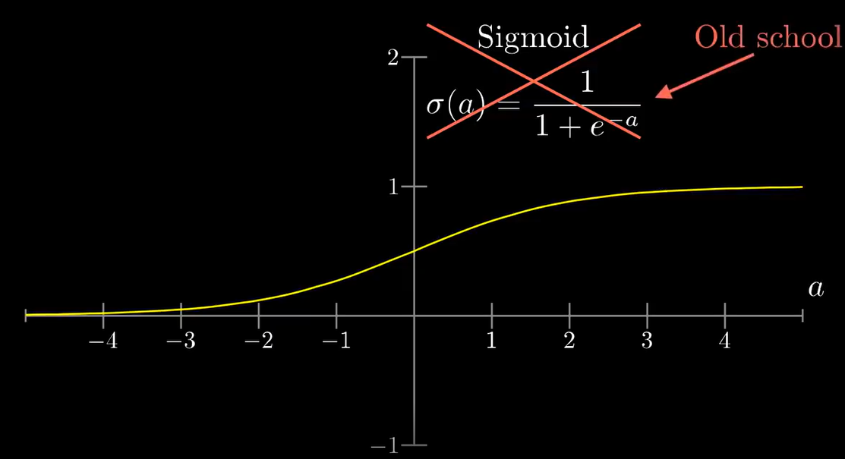

Slide 27
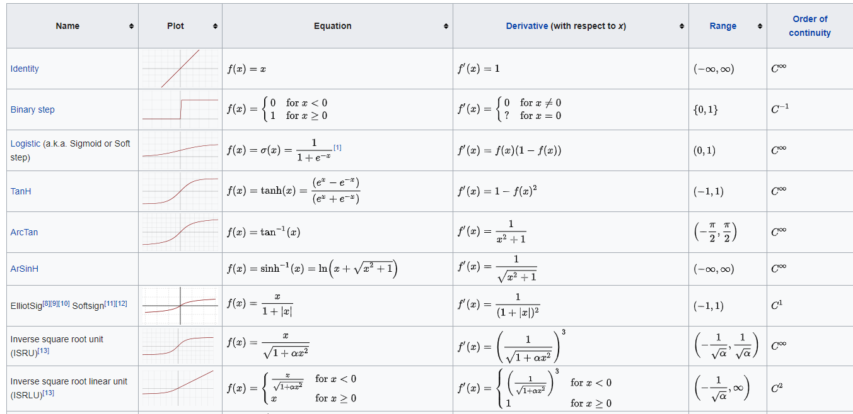
Type of Activation Functions

Slide 28
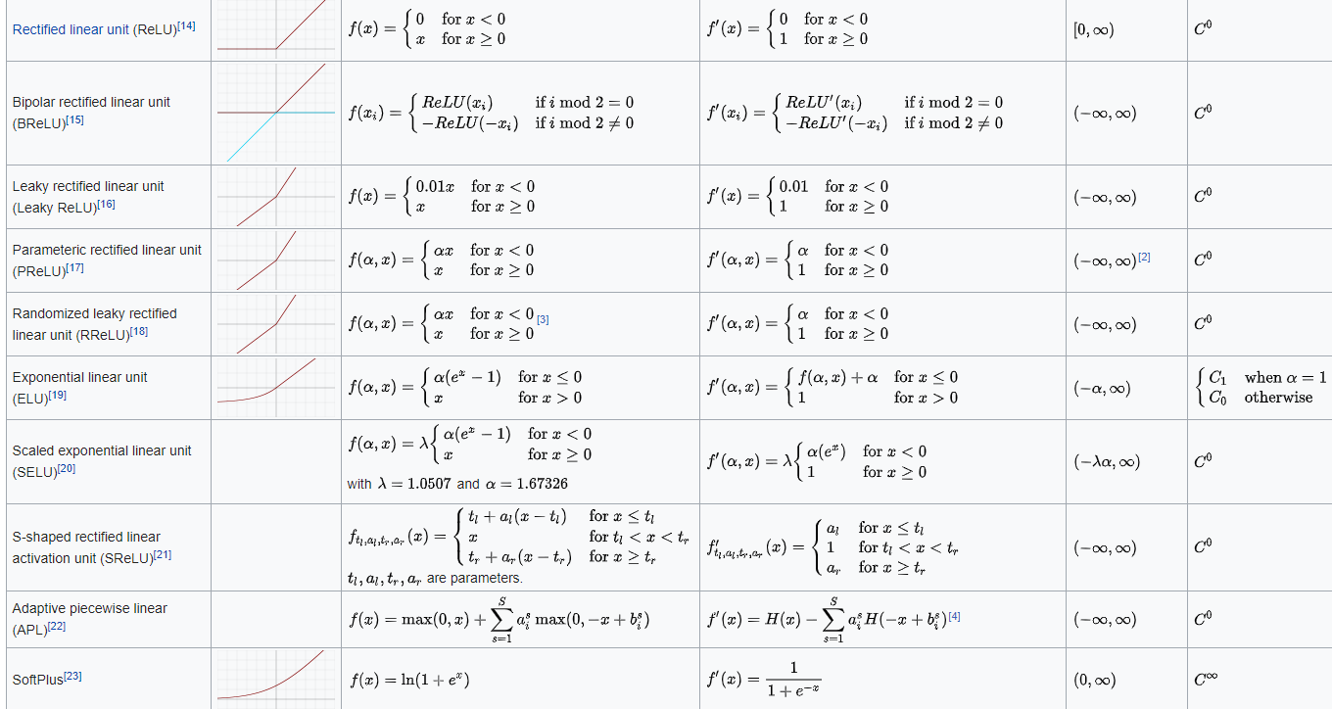
Type of Activation Functions

Slide 29
Cost Functions

Slide 30
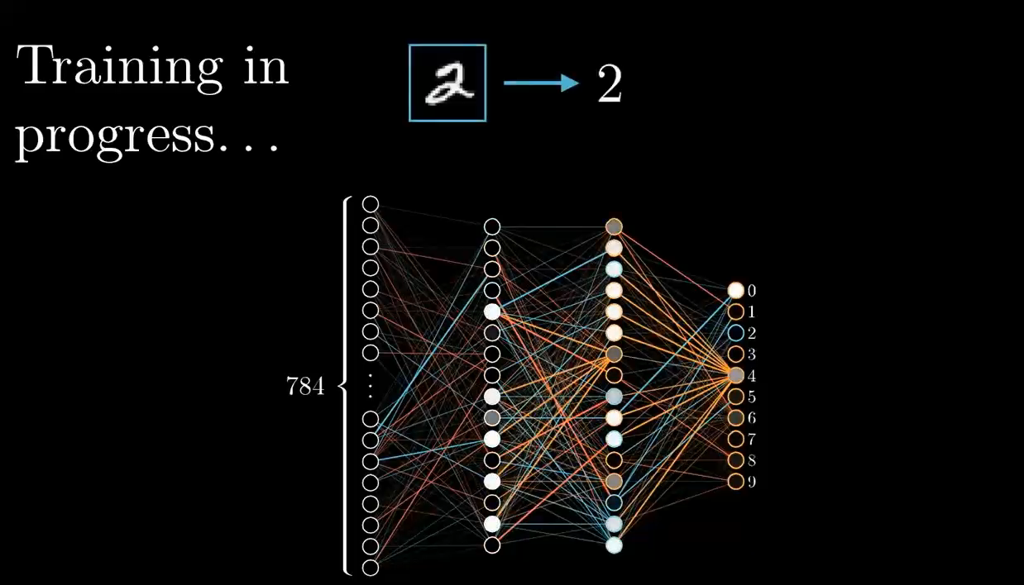

Slide 31
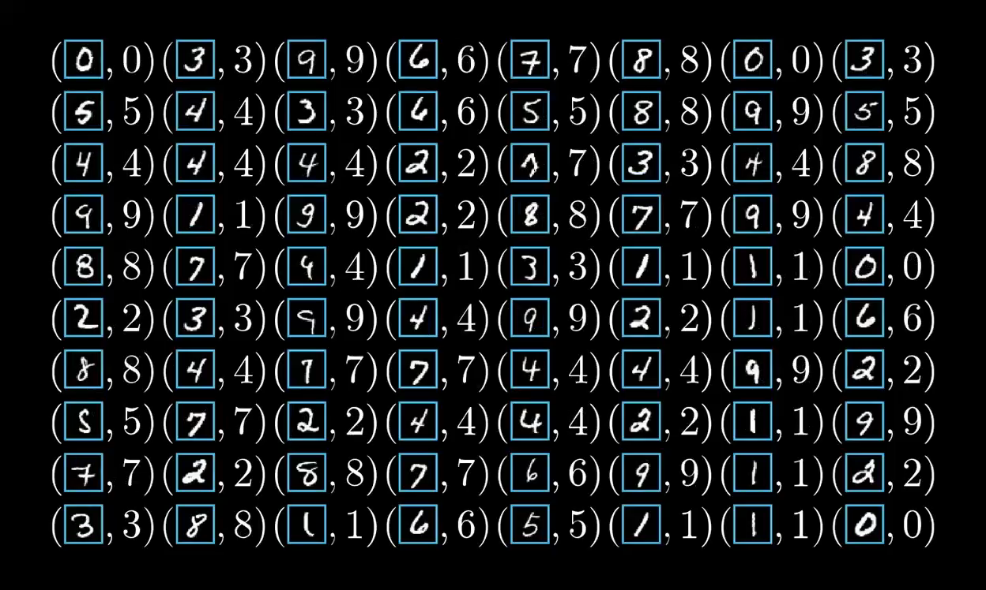

Slide 32
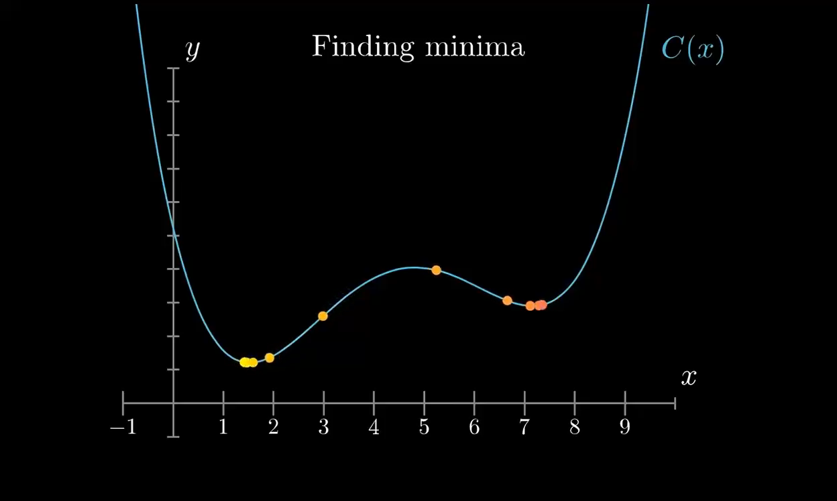

Slide 33
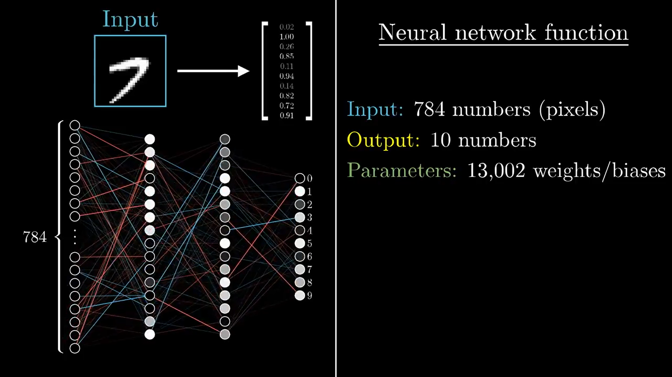
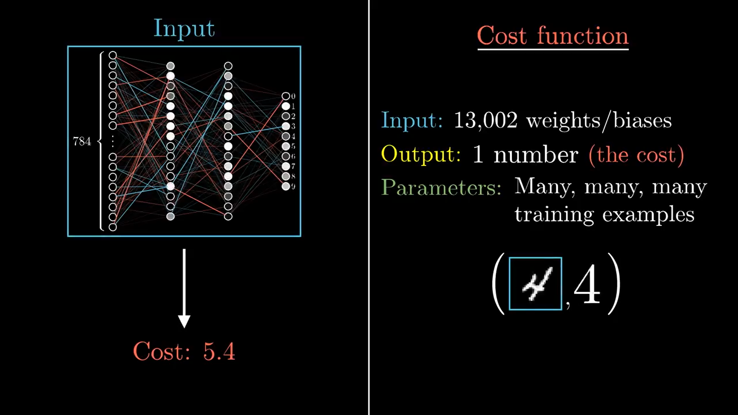

Slide 34
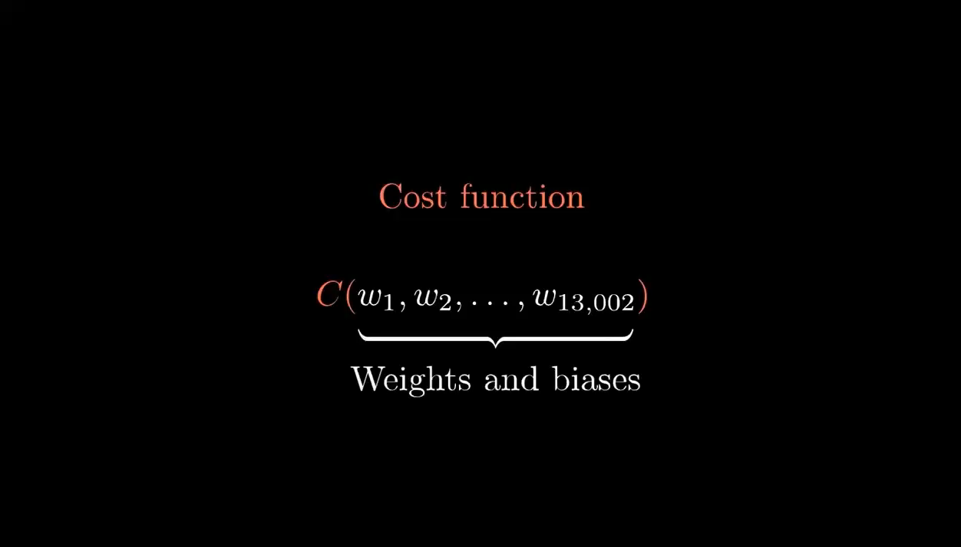

Slide 35
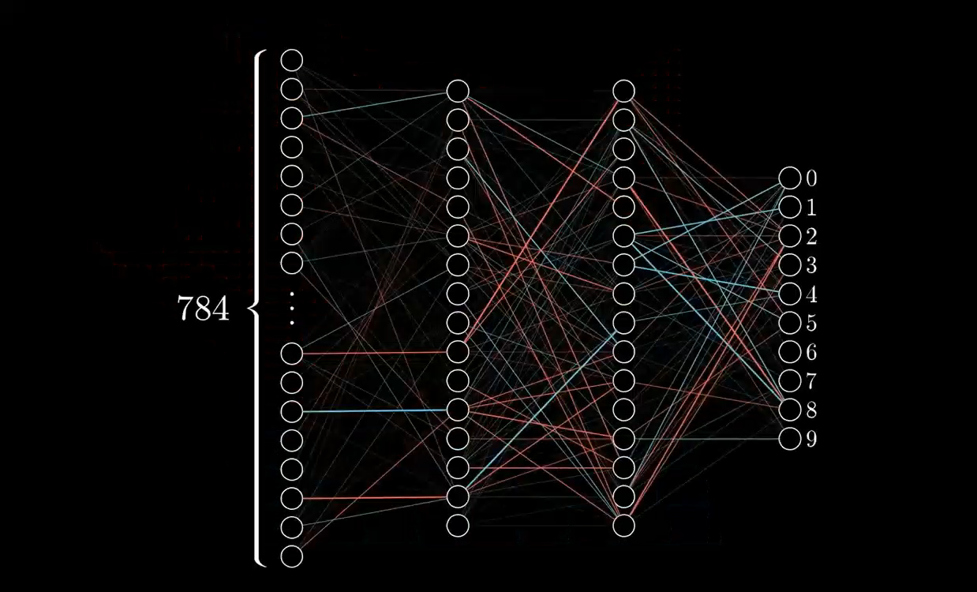

Slide 36
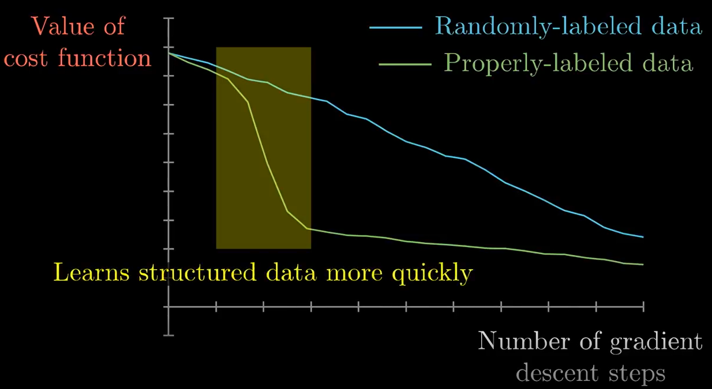
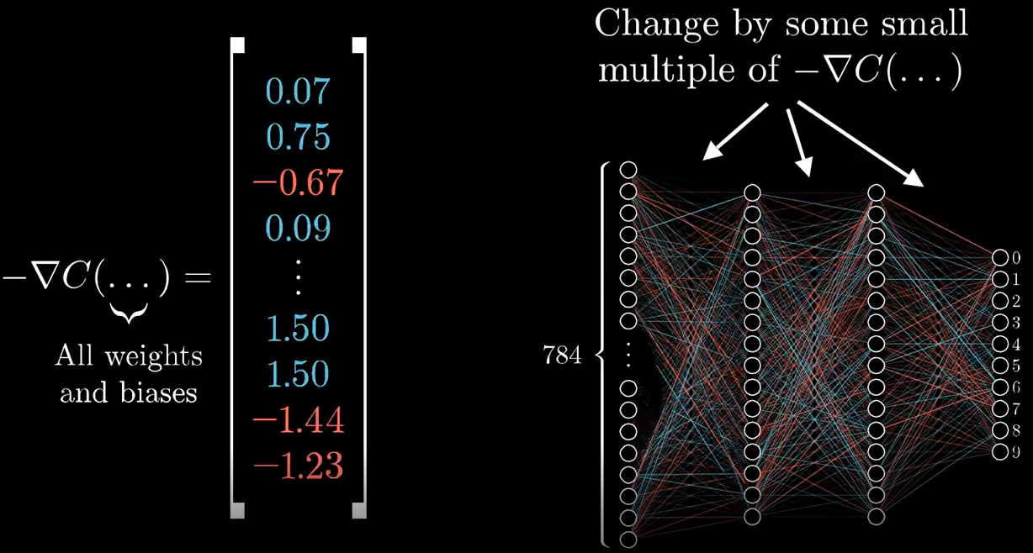

Slide 37
What is Back Propagation
Back propagation concept helps neural networks to improve their accuracy.
In traditional software application, a number of functions are coded. These functions take in inputs and produce an output. The inputs are not used to update the instructions.
However neural networks are artificially intelligent. They can learn and improve themselves.

Slide 38
What is Back Propagation
When neural networks are trained, a range of inputs are passed along with corresponding expected output. Activation functions then produce an output from the set of inputs.
When the actual result is different than the expected result then the weights applied to neurons are updated. Sometimes the expected and actual results are within the error threshold and neural network is considered optimal.

Slide 39
What is Back Propagation
However occasionally, the expected output is different than the actual output. As a consequence, information is feedback into the network and the weights and biases are enhanced. This process is recursive in nature and is known as back propagation.
Back Propagation Process Makes Algorithms Self-Learning

Slide 40
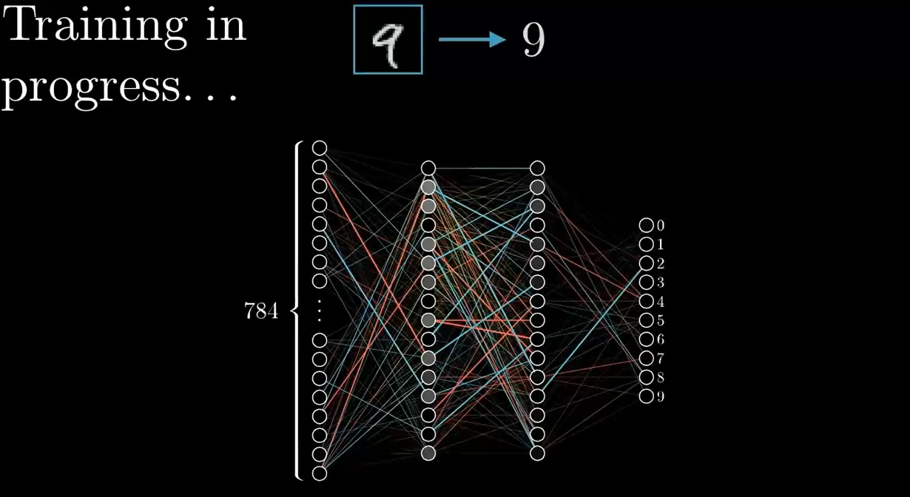
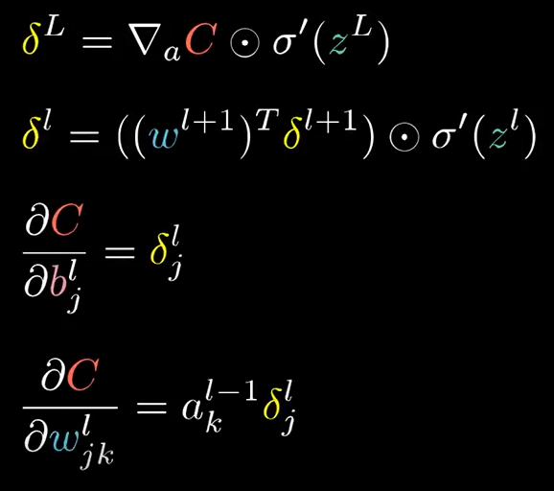

Slide 41
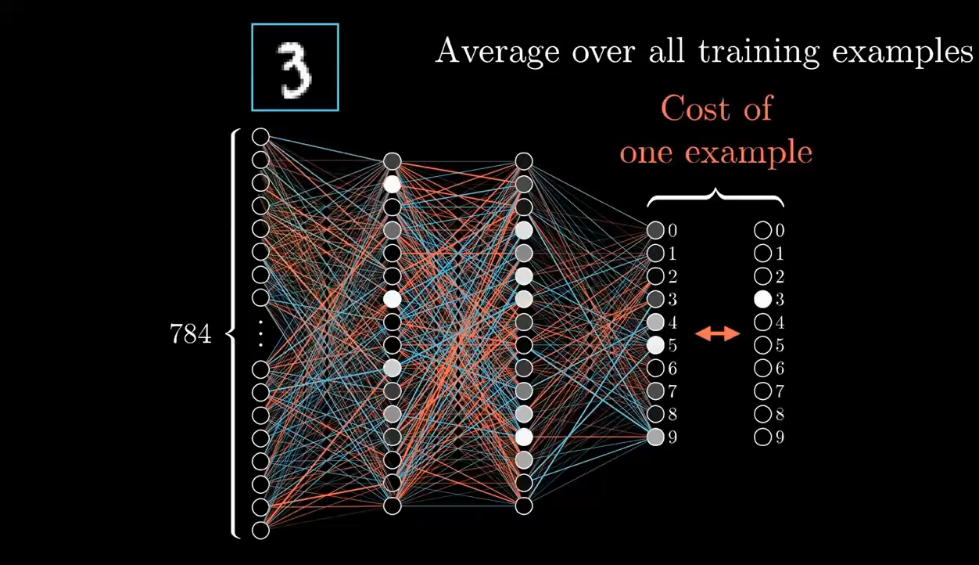

Slide 42
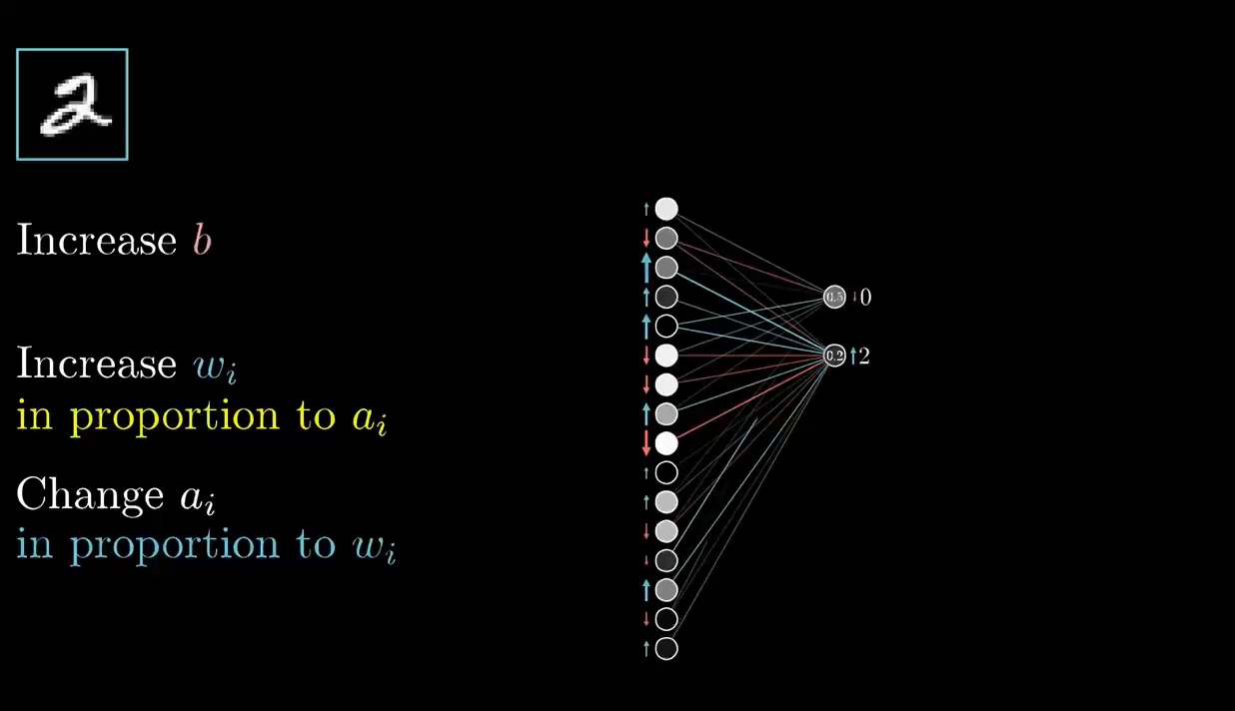

Slide 43
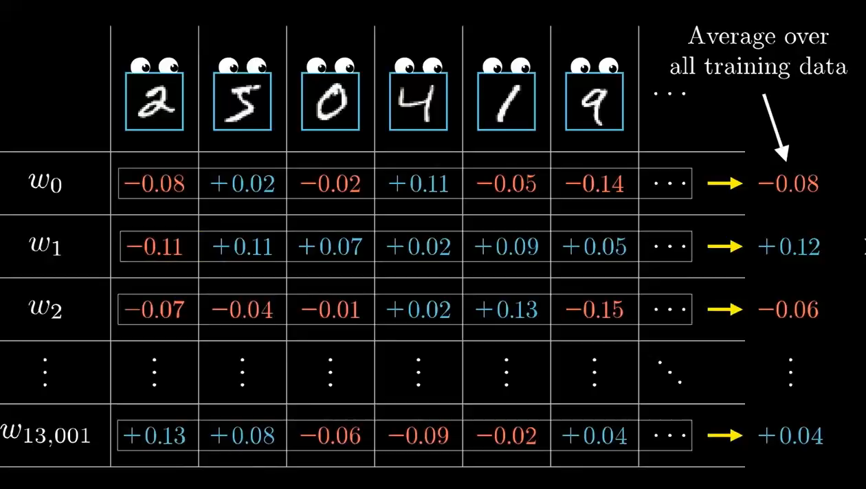

Slide 44
Introduction of Neural Network for Deep Learning
Zendi Iklima S.T, S.Kom, M.Sc

Slide 45
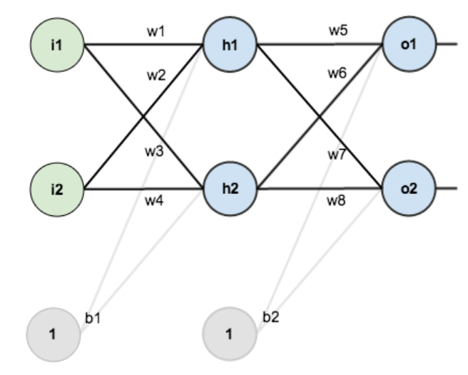
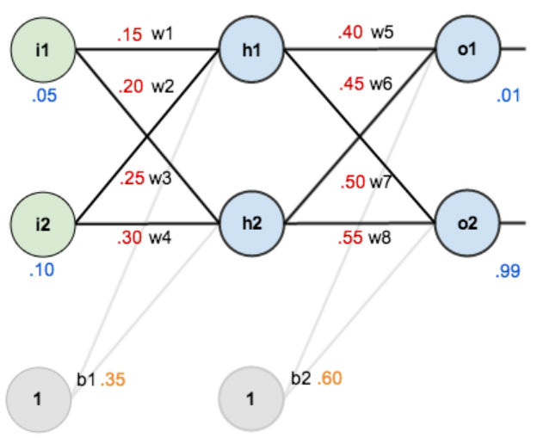
Notes:
https://mattmazur.com/2015/03/17/a-step-by-step-backpropagation-example/
https://github.com/mattm/simple-neural-network/blob/master/neural-network.py

Slide 46
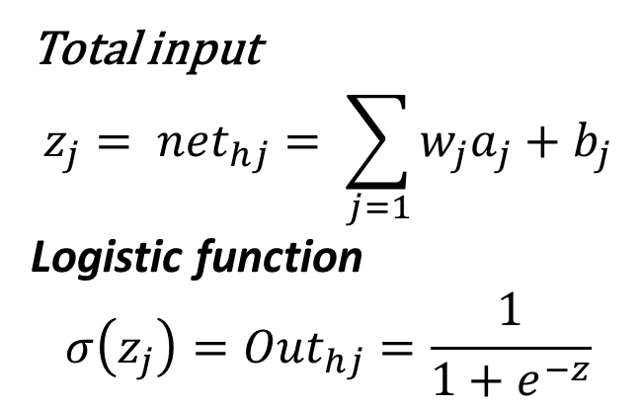
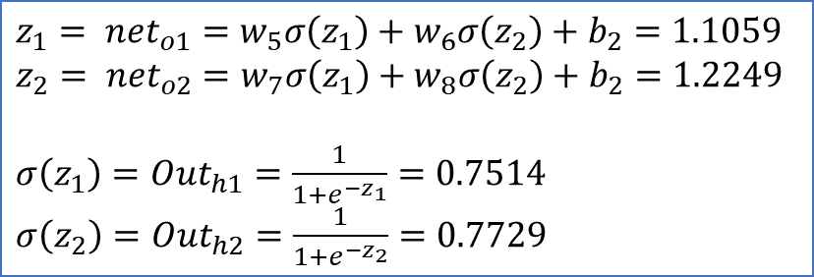
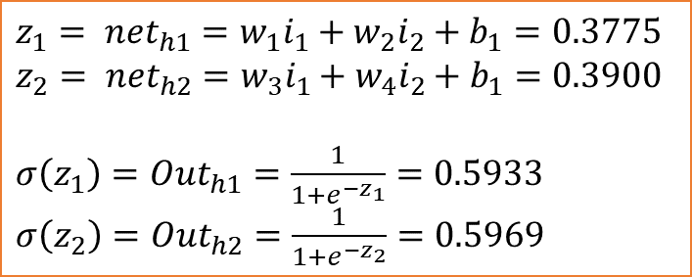
Total input
$$z_{j}= {net}_{hj}= \sum_{j=1}{w_{j}a_{j}+b_{j}}$$
Logistic function
$$σ\left(z_{j}\right)={Out}_{hj}=\frac{1}{1+e^{−z}}$$
The Forward Pass
We figure out the total net input to each hidden layer neuron, squash the total net input using an activation function (here we use the logistic function), then repeat the process with the output layer neurons.
$z_{1}= {net}_{h1}=w_{1}i_{1}+w_{2}i_{2}+b_{1}=0.3775$
$z_{2}= {net}_{h2}=w_{3}i_{1}+w_{4}i_{2}+b_{1}=0.3900$
$σ\left(z_{1}\right)={Out}_{h1}=\frac{1}{1+e^{−z_{1}}}=0.5933$
$σ\left(z_{2}\right)={Out}_{h2}=\frac{1}{1+e^{−z_{2}}}=0.5969$
$z_{1}= {net}_{o1}=w_{5}σ\left(z_{1}\right)+w_{6}σ\left(z_{2}\right)+b_{2}=1.1059$
$z_{2}= {net}_{o2}=w_{7}σ\left(z_{1}\right)+w_{8}σ\left(z_{2}\right)+b_{2}=1.2249$
$σ\left(z_{1}\right)={Out}_{h1}=\frac{1}{1+e^{−z_{1}}}=0.7514$
$σ\left(z_{2}\right)={Out}_{h2}=\frac{1}{1+e^{−z_{2}}}=0.7729$

Slide 47
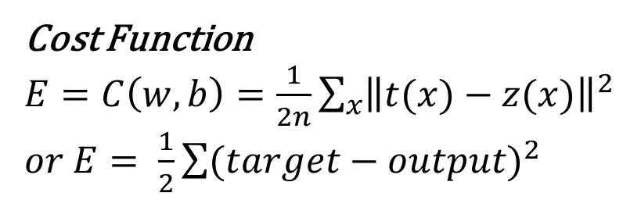
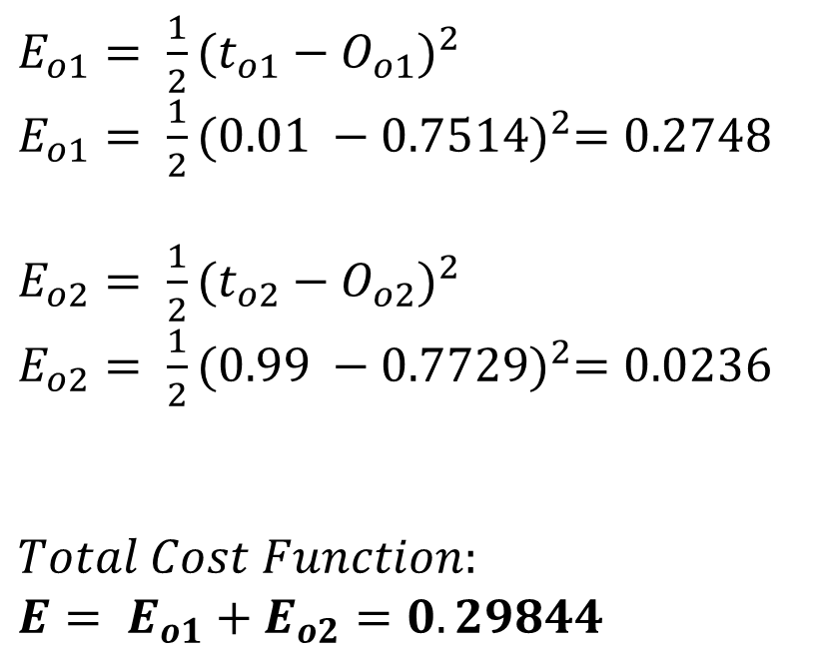
Cost Function
$E=C\left(w, b\right)=\frac{1}{2n}\sum_{x}{{\left\|t(x)−z(x)\right\|}^{2}}$
$or E= \frac{1}{2}\sum{(target−output)^{2}}$
We figure out the total net input to each hidden layer neuron, squash the total net input using an activation function (here we use the logistic function), then repeat the process with the output layer neurons.
$E_{o1}= \frac{1}{2}{(t_{o1}−O_{o1})}^{2}$
$E_{o1}= \frac{1}{2}{(0.01 −0.7514)}^{2}=0.2748$
$E_{o2}= \frac{1}{2}{(t_{o2}−O_{o2})}^{2}$
$E_{o2}= \frac{1}{2}{(0.99 −0.7729)}^{2}=0.0236$
$Total Cost Function:$
${E= E}_{o1}+E_{o2}=0.29844$

Slide 48
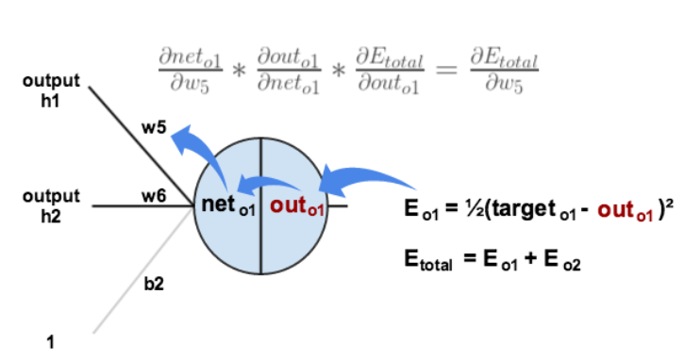
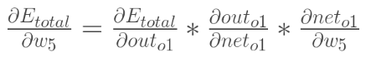



How much does total error change with the respect to the output?
$E= \frac{1}{2}{(t_{o1}−O_{o1})}^{2}+\frac{1}{2}{(t_{o2}−O_{o2})}^{2}$
$\frac{∂E}{∂O_{o1}}=2×\frac{1}{2}×(t_{o1}−O_{o1})^{2−1}×−1+0$
$\frac{∂E}{∂O_{o1}}=−\left(t_{o1}−O_{o1}\right)=\left(0.7514−0.01\right)=0.7414$
How much does the output of $\left(o_{1}\right)$ change with the respect to its total net input?
If $O_{o1}=\frac{1}{1+e^{{−net}_{o1}}}$ then,
$\frac{∂O_{o1}}{∂{net}_{o1}}=O_{o1}\left(1−O_{o1}\right)=0.7514 \left(1−0.7514\right)=0.1868$
How much does the total net input of $\left(o_{1}\right)$ change with respect to $ω_{5}?$
${net}_{o1}=w_{5}σ\left(z_{1}\right)+w_{6}σ\left(z_{2}\right)+b_{2}$
$\frac{∂{net}_{o1}}{∂w_{5}}=1×$ $O_{h1}× {(w_{5})}^{1−1}+0+0= O_{h1}=0.5933$
THEN,
$\frac{∂E}{∂w_{5}}=\frac{∂E}{∂O_{o1}}×\frac{∂O_{o1}}{∂{net}_{o1}}×\frac{∂{net}_{o1}}{∂w_{5}}=0.0822$
The Backwards Pass
The goal of backpropagation is to optimize the weights so that the neural network can learn how to correctly map arbitrary inputs to outputs.
chain rules

Slide 49


The Backwards Pass
The goal of backpropagation is to optimize the weights so that the neural network can learn how to correctly map arbitrary inputs to outputs.
chain rules

Slide 50


The Backwards Pass
The goal of backpropagation is to optimize the weights so that the neural network can learn how to correctly map arbitrary inputs to outputs.
To decrease the error, we then subtract this value from the current weight (optionally multiplied by some learning rate, eta, which we’ll set to 0.5):
$w_{5}^{+}=w_{5}−η×\frac{∂E}{∂w_{5}}=0.4 −0.5 ×0.0822=0.3589$
Then,
$w_{6}^{+}=$ 0.4087
$w_{7}^{+}=$ 0.5113
$w_{8}^{+}=$ 0.5614
chain rules
We perform the actual updates in the neural network after we have the new weights leading into the hidden layer neurons (ie, we use the original weights, not the updated weights, when we continue the backpropagation algorithm below).

Slide 51




Find the solution for:
$\frac{∂E}{∂w_{1}}=\frac{∂E}{∂O_{h1}}×\frac{∂O_{h1}}{∂{net}_{h1}}×\frac{∂{net}_{h1}}{∂w_{1}}$
$\frac{∂E}{∂O_{h1}}=\frac{∂E_{o1}}{∂O_{h1}}+\frac{∂E_{o2}}{∂O_{h2}}$
$\frac{∂E_{o1}}{∂O_{h1}}=\frac{∂E_{o1}}{∂{net}_{o1}}×\frac{∂{net}_{o1}}{∂O_{h1}}$
$\frac{∂E_{o1}}{∂{net}_{o1}}=\frac{∂E_{o1}}{∂O_{o1}}×\frac{∂O_{o1}}{∂{net}_{o1}}=0.7414 ×0.1868=0.1385$
Remember $\frac{∂{net}_{o1}}{∂O_{h1}}= w_{5}=0.4 → {net}_{o1}=w_{5}$ $O_{h1}+$ $w_{6}$ $O_{h2}+b_{2}$
Then $\frac{∂E_{o1}}{∂O_{h1}}=\frac{∂E_{o1}}{∂{net}_{o1}}×\frac{∂{net}_{o1}}{∂O_{h1}}=0.1385 ×0.4=0.05540$
After, get $\frac{∂E_{o2}}{∂O_{h2}}=−0.0191$
Therefore: $\frac{∂E}{∂O_{h1}}=\frac{∂E_{o1}}{∂O_{h1}}+\frac{∂E_{o2}}{∂O_{h2}}=0.05540+\left(−0.0191\right)=0.0364$
$\frac{∂O_{h1}}{∂{net}_{h1}}=O_{h1}\left(1−O_{h1}\right)=0.5933\left(1−0.5933\right)=0.2413$
$\frac{∂{net}_{h1}}{∂w_{1}}= i_{1}=0.05→ {net}_{h1}=w_{1} i_{1}+ w_{2} i_{2}+b_{1}$
Finally, $\frac{∂E}{∂w_{1}}=\frac{∂E}{∂O_{h1}}×\frac{∂O_{h1}}{∂{net}_{h1}}×\frac{∂{net}_{h1}}{∂w_{1}}=0.00044$
The Hidden Layer
Backwards pass must be completed by calculating new values for $w_{1},w_{2},w_{3} and{ w}_{4}$

Slide 52


The Hidden Layer
Backwards pass must be completed by calculating new values for $w_{1},w_{2},w_{3} and{ w}_{4}$
To decrease the error, we then subtract this value from the current weight (optionally multiplied by some learning rate, eta, which we’ll set to 0.5):
$w_{1}^{+}=w_{1}−η×\frac{∂E}{∂w_{1}}=0.15−0.5×0.00044=0.1498$
Then,
$w_{2}^{+}=$ 0.1996
$w_{3}^{+}=$ 0.2498
$w_{4}^{+}=$ 0.2995

Slide 53
Finally, we’ve updated all of our weights! When we fed forward the 0.05 and 0.1 inputs originally, the error on the network was 0.298371109. After this first round of backpropagation, the total error is now down to 0.291027924. It might not seem like much, but after repeating this process 10,000 times, for example, the error plummets to 0.0000351085. At this point, when we feed forward 0.05 and 0.1, the two outputs neurons generate 0.015912196 (vs 0.01 target) and 0.984065734 (vs 0.99 target).

Slide 54


Slide 55


https://nodejs.org/en/

Slide 56


Slide 57


Slide 58

express app –view=ejs

Slide 59


Slide 60


Slide 61






Slide 62












Slide 63

Update?

Slide 64







Slide 65



